Slide 1
X42619 beamtime
August 24, 2021
Ryan N Coffee
coffee@slac.stanford.edu
Notes:
<number>

Slide 2
Accomplishments
Preliminary
~0.5 eV resolution at 100 eV above retardation
Suppressed magnetic field deflection of low energy electrons
Sub-sampling resolved waveform in pre-processing
Multi-retardation for extended multi-color or multi-edge methods
Partial wave analysis of emission as surrogate for spectral-polarimetry
Left to do
Single shot spectra from ~10s of counts/ToF
FPGA implementation of featurization
Single-shot pulse reconstruction via 3 micron streaking
<number>
Notes:
<number>

Slide 3
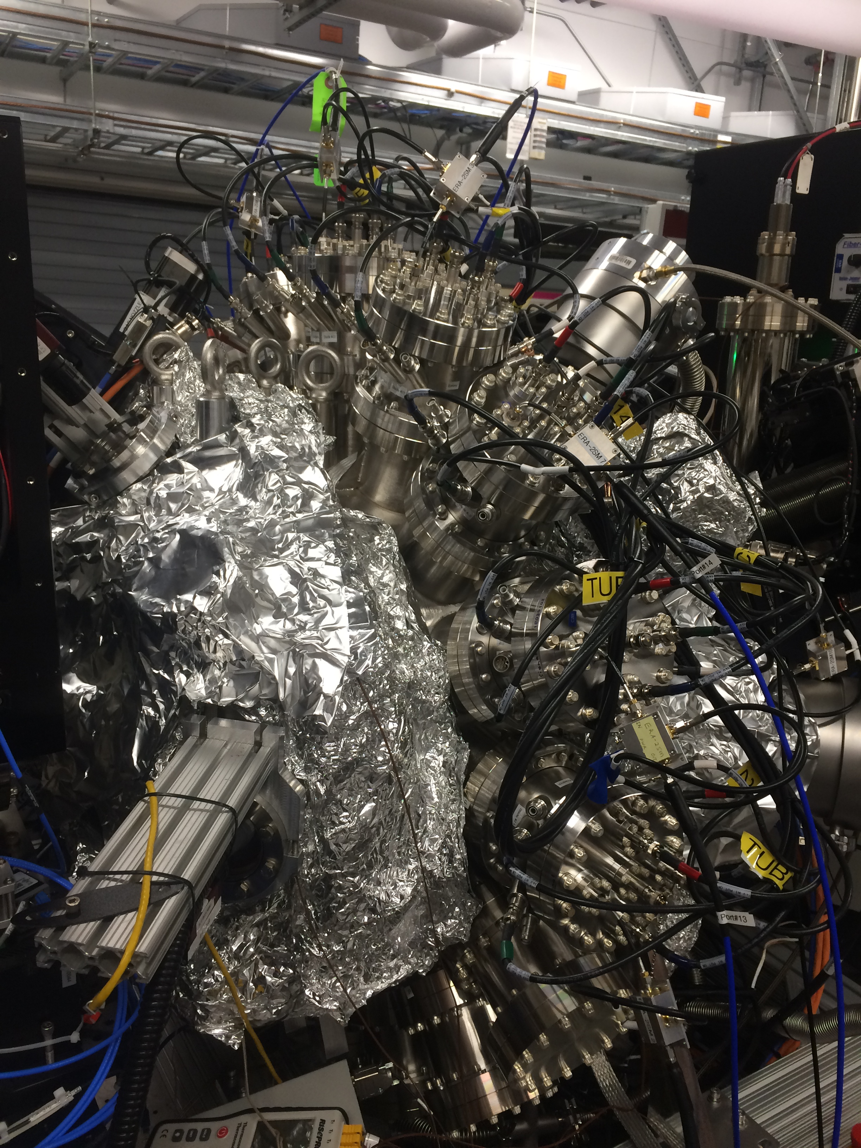
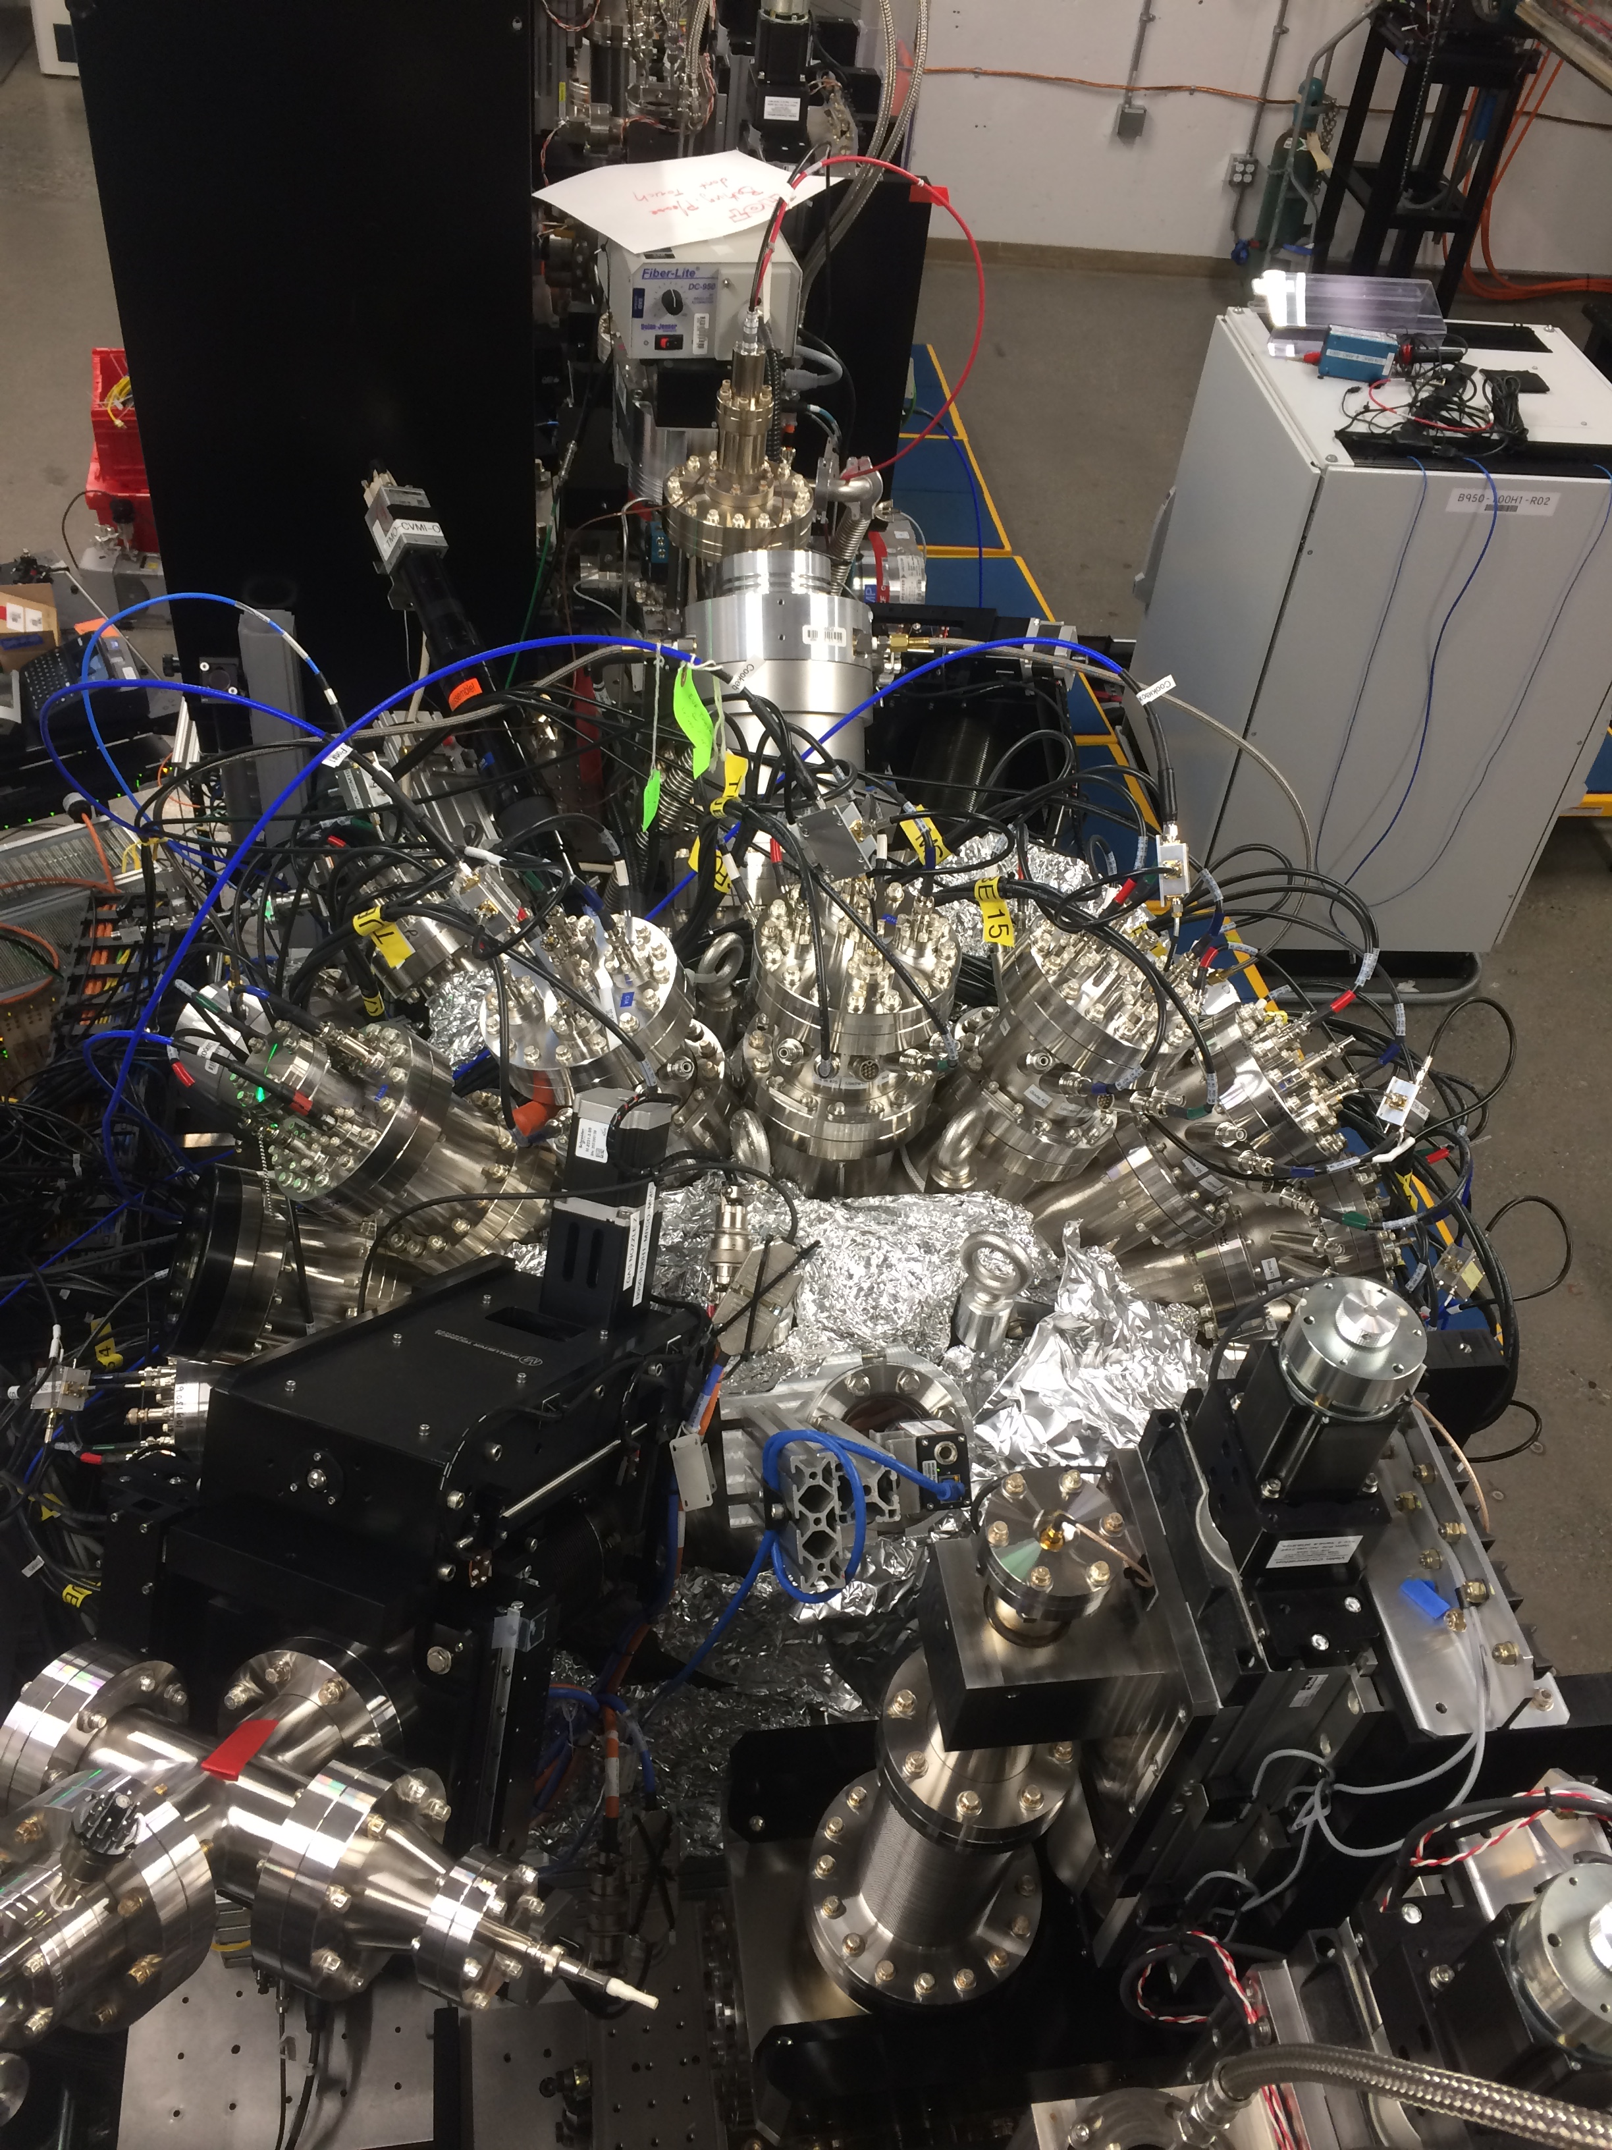
Installed system
Side view
Top view
Cite submitted paper
<number>
Notes:
<number>

Slide 4
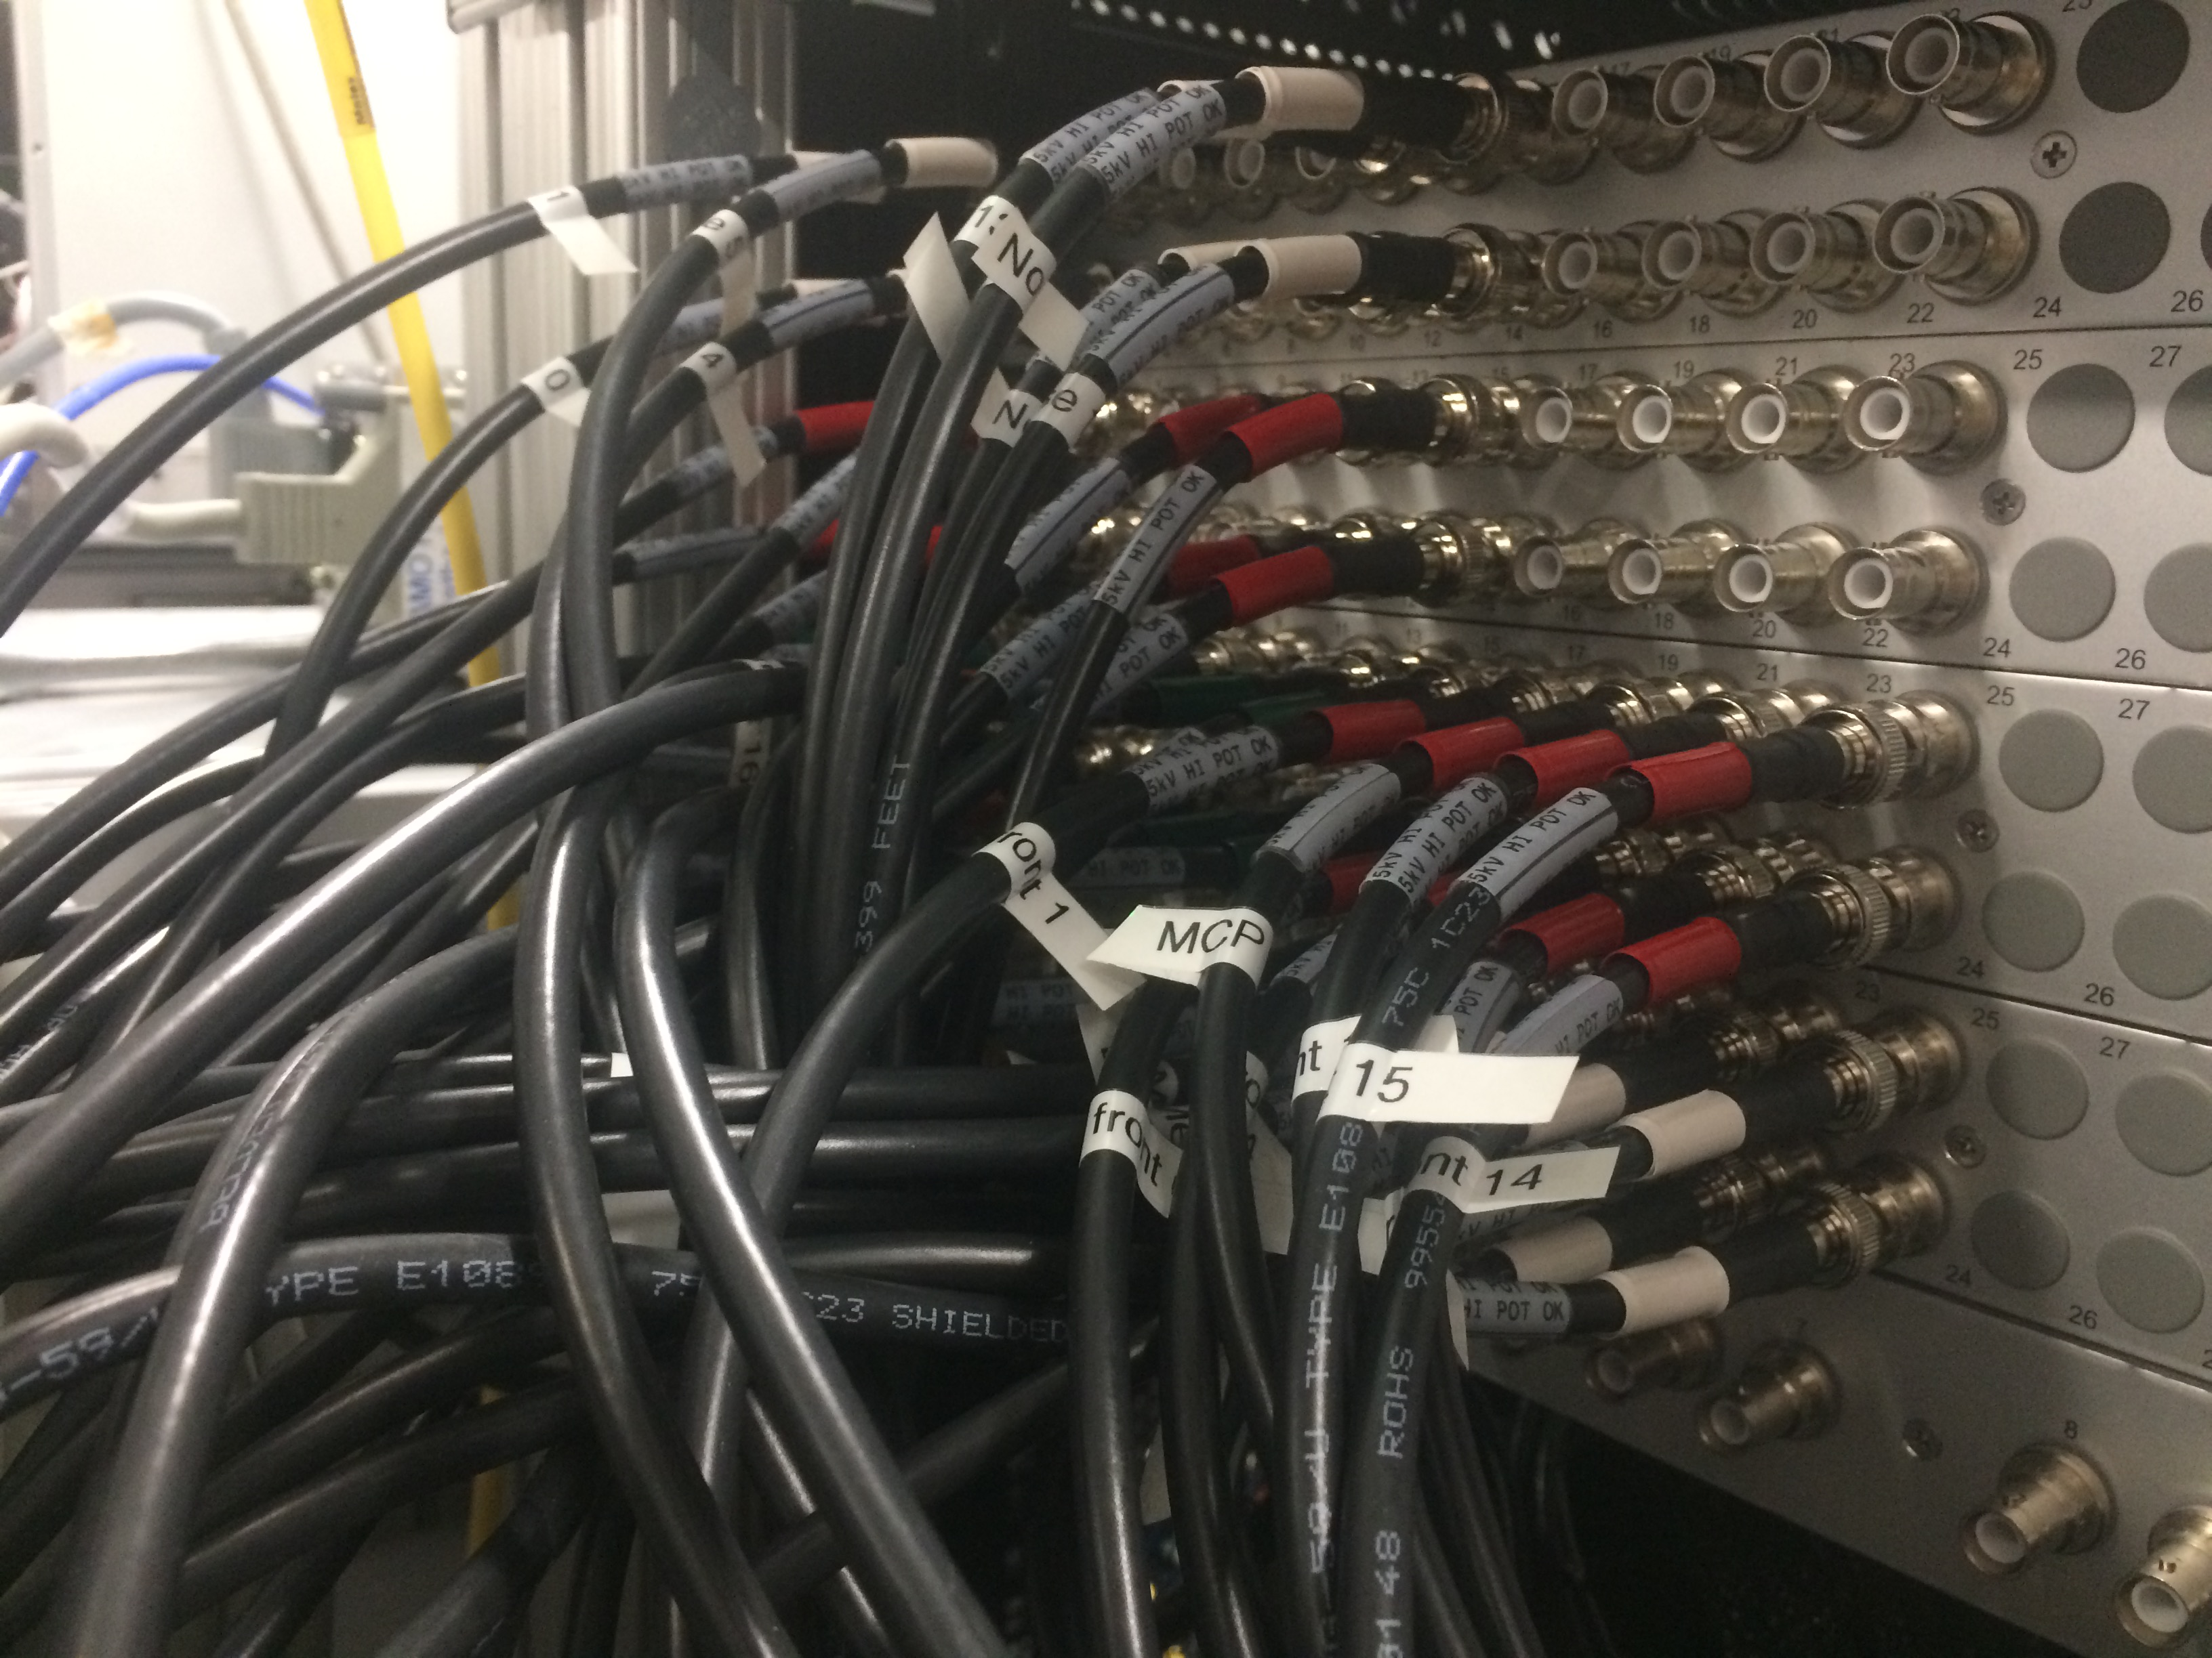
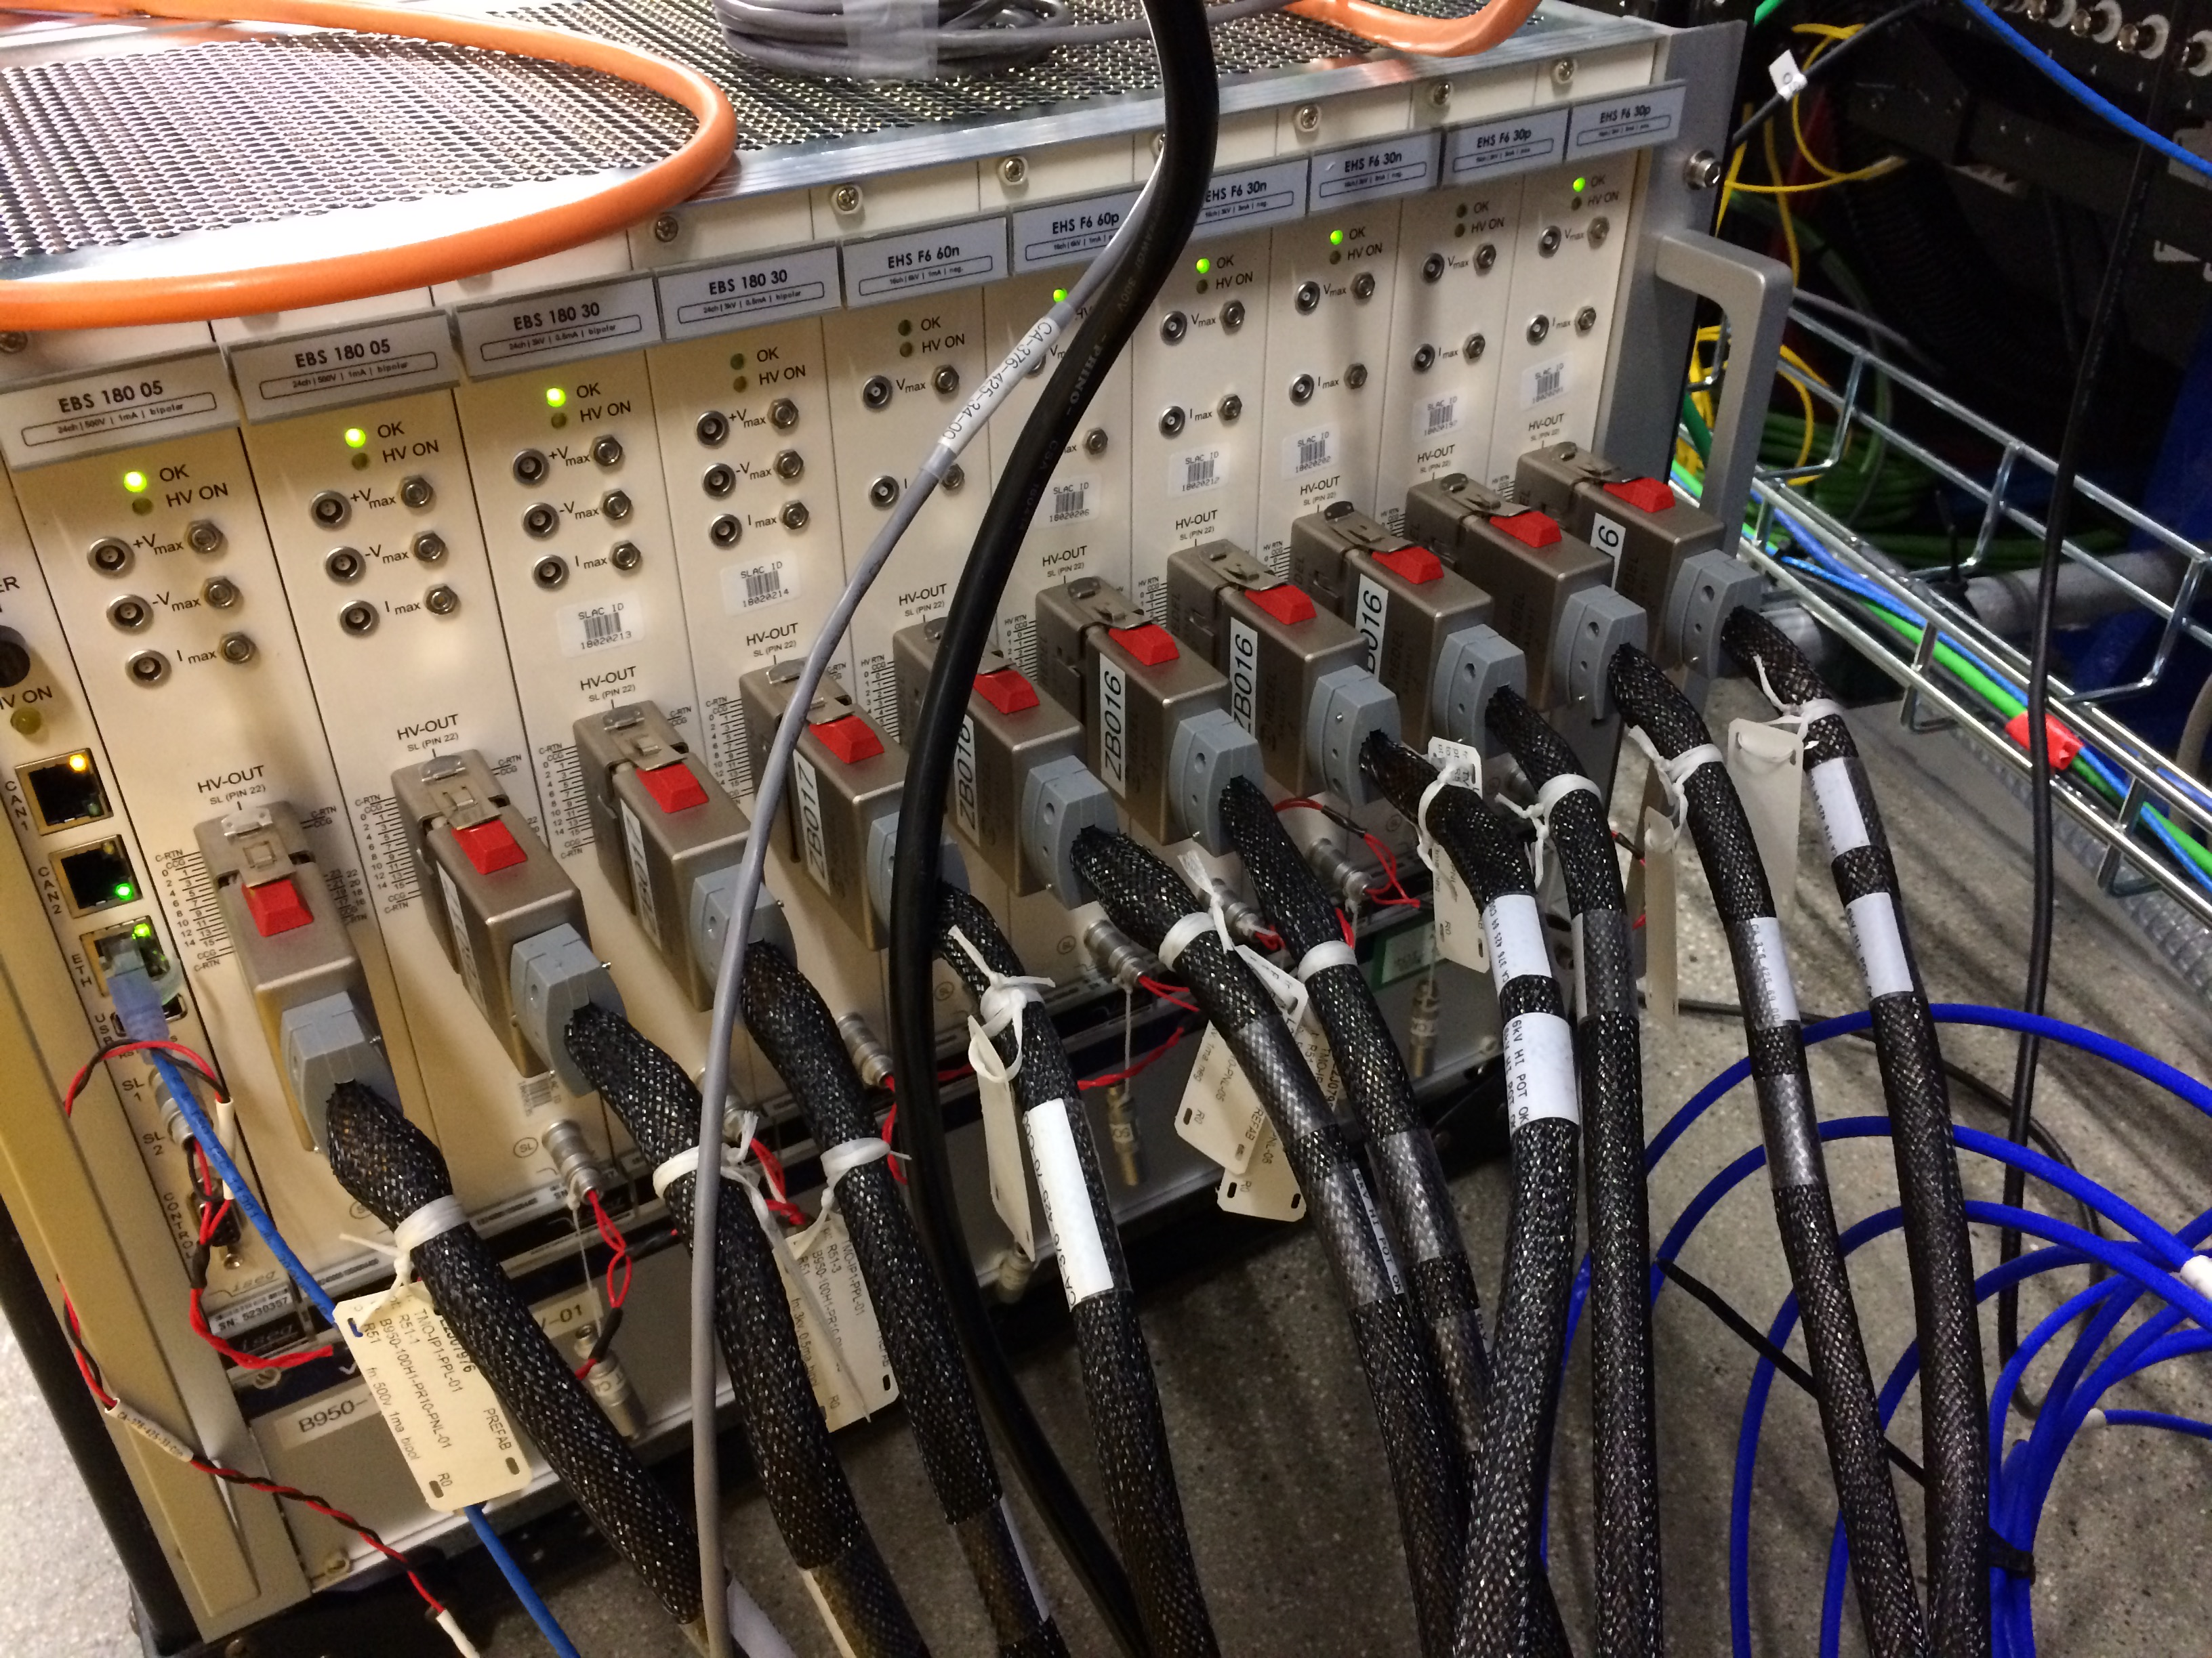
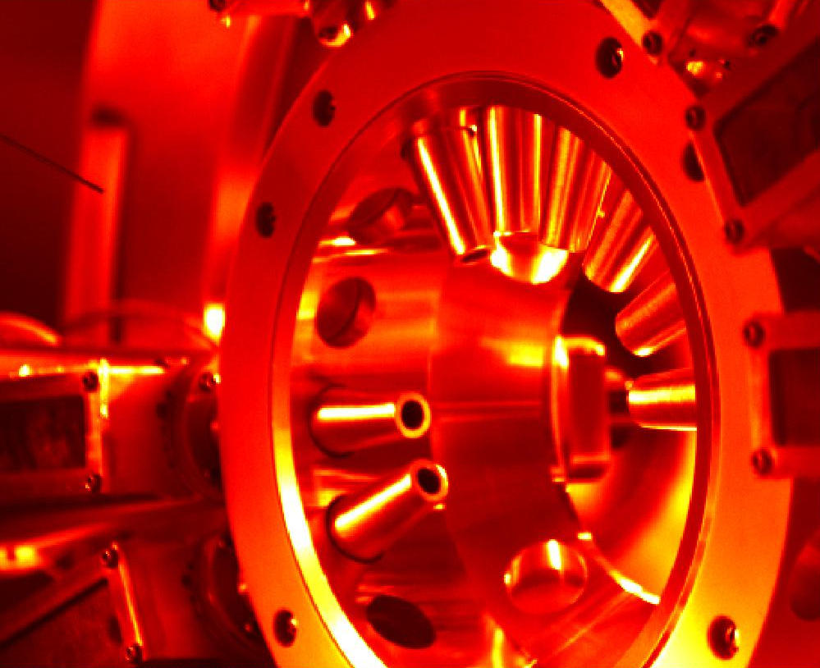
The system build out
8 ToFs installed, 2 bare MCPs for “Current mode” resilience testing
Positioning paddle, Gas needle, 4 pumps
MPod High Density cables → 70 SHV cables from patch panel, a nightmare for Andrei, Aalayah and Nolan
Full build out would require 160 SHV channels
The 9-pin feed through failed (removing from XIP chamber design)
Ideally design High Density vacuum feedthroughs
<number>
Notes:
<number>

Slide 5
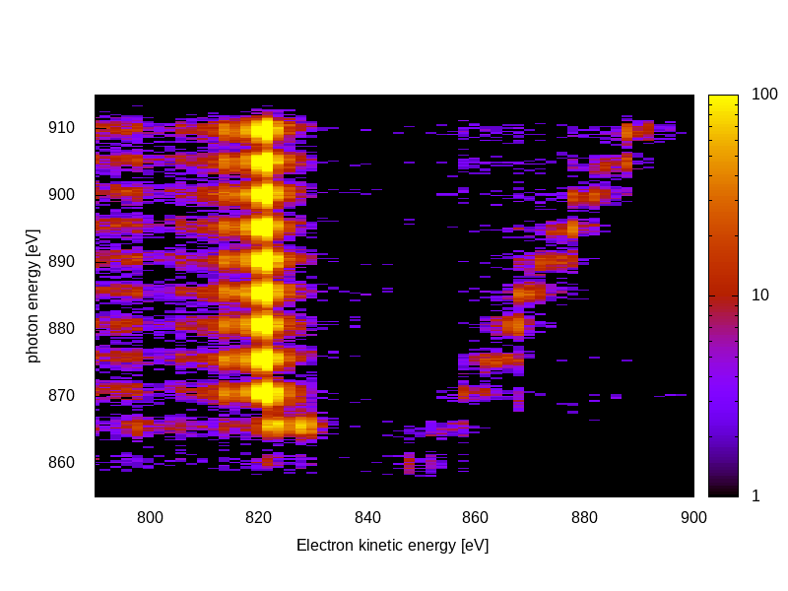
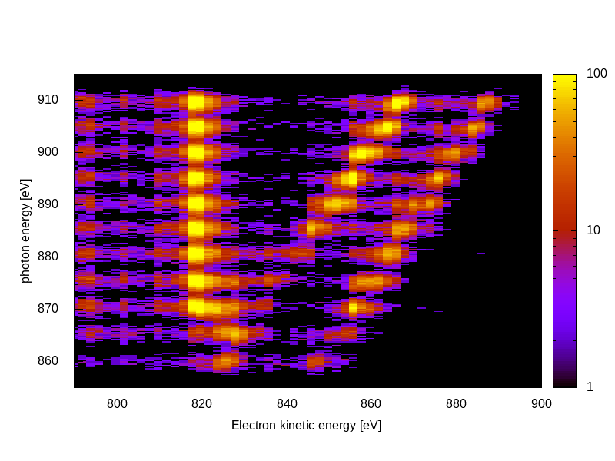
Neon Auger and valence photos
Roughly 2 eV / bin at 800 eV
No collection efficiency compensation… raw counts agree (qualitatively) with calculated cross-sections
KLL
2s
2p
KLL
2s
2p
Vertical Horizontal
<number>
Notes:
<number>

Slide 6
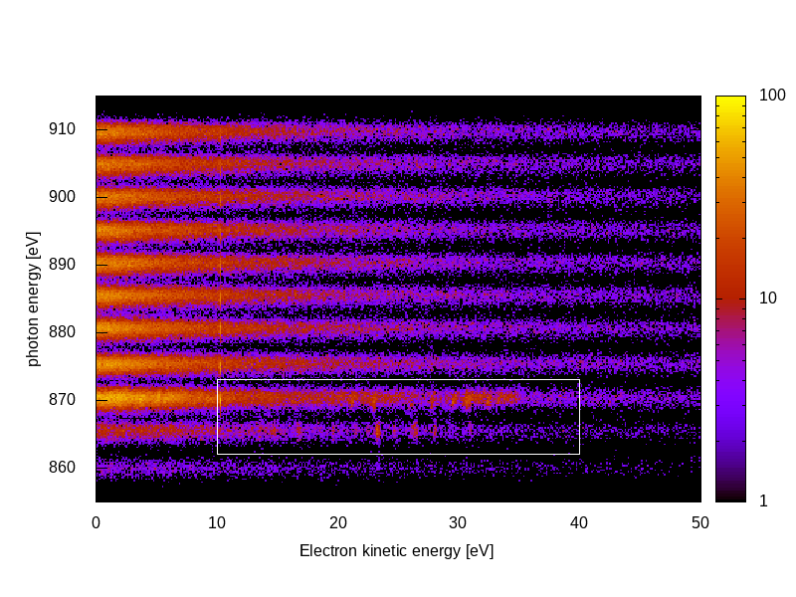
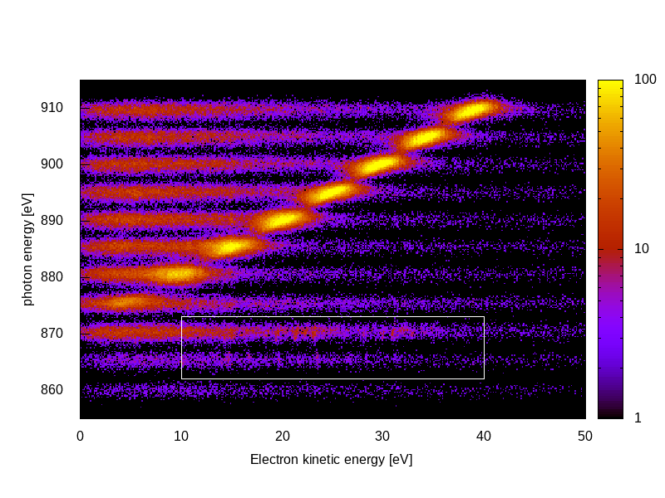
Neon Photos and Autoionizing 1s→3p resonance
Low energy electrons highly sensitive to magnetic fields
Previous CookieBox experienced significant dependence of angular patterns to Helmholtz coil nulling fields
Steel chamber tests were blind below 30eV
Vertical Horizontal
Secondaries
Magnetic field
supression
Autoionization
<number>
Notes:
<number>

Slide 7
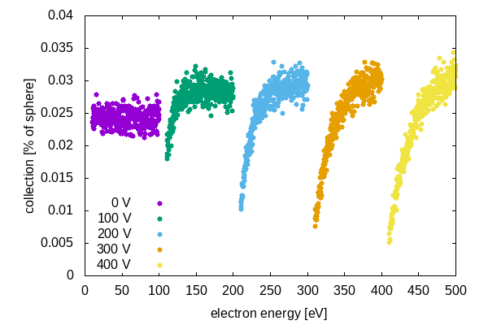
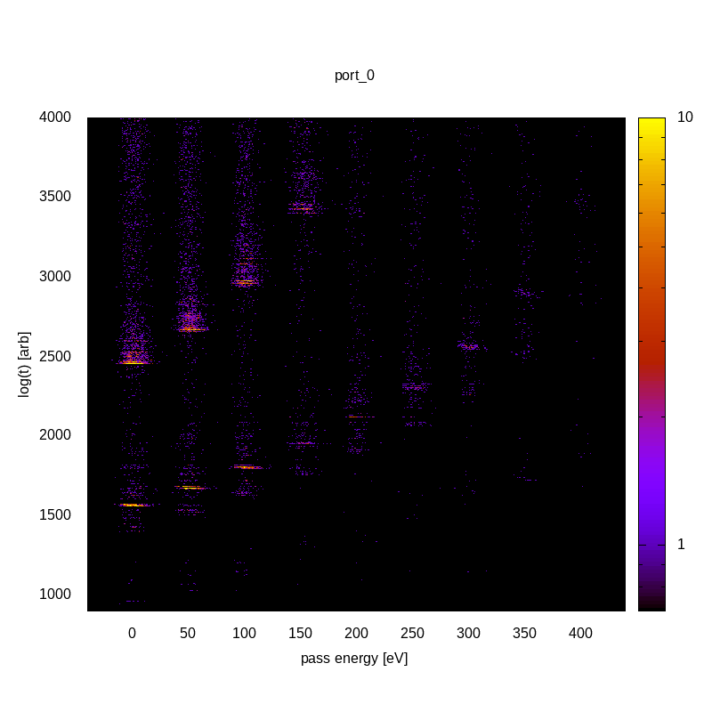
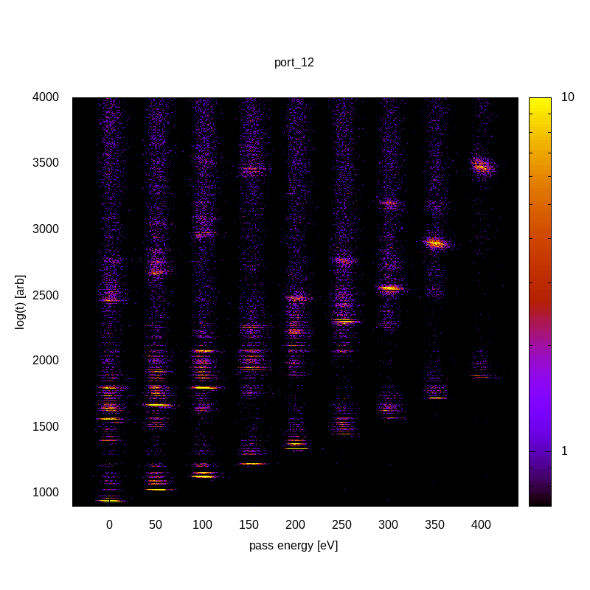
Collection versus retardation
Loss of slow electrons only for highest retardations
Partial waves can be analyzed versus retardation to look for magnetic deflection in drift tube
Vertical
Horizontal
<number>
Notes:
<number>

Slide 8
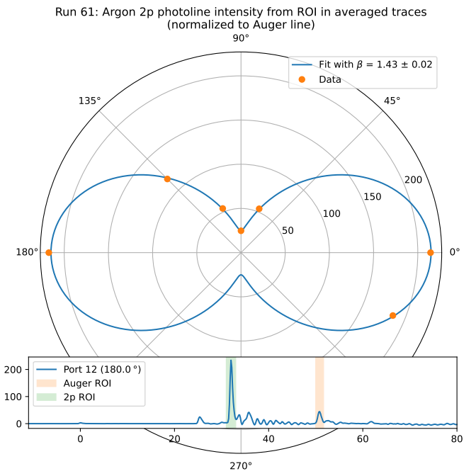
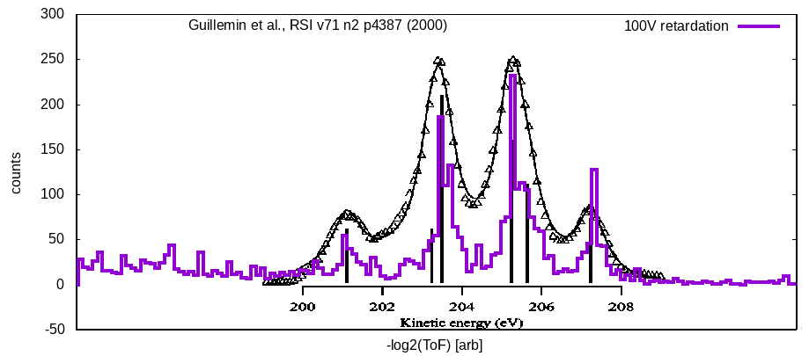
Angle and spectral resolution
Raw signals, averaged, normalized by LMM Auger yields
Β = 1.43 measured vs 1.465 theory
Validates use as polarimeter
Preliminary ½ eV resolution of Ar LMM lines … need to discount aliasing in histograms
Courtesy Lars Funke
<number>
Notes:
<number>

Slide 9
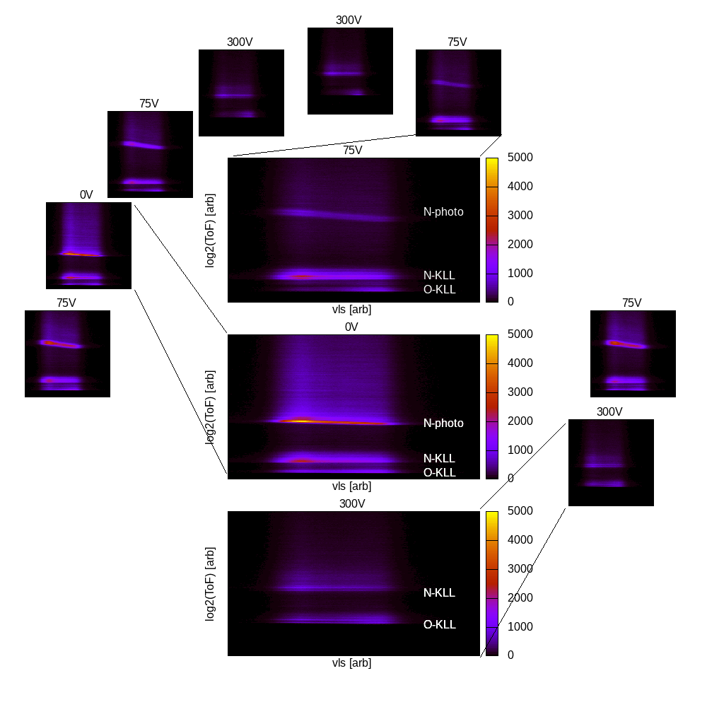
Multi-edge resolution
N₂O Resonant Auger
N 1s photoelectrons
N KLL and O KLL Auger electrons
Surrogate demonstration for multi-color measurements
Port 13 short triggered ToF modifications as well as provided consistent “no retardation” channel during beamtime ;-)
<number>
Notes:
<number>

Slide 10

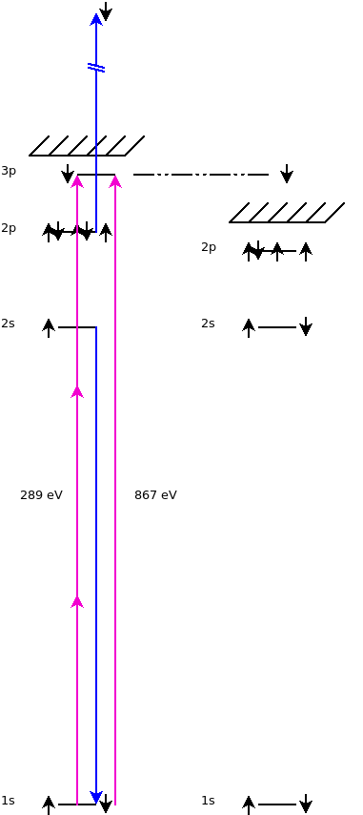
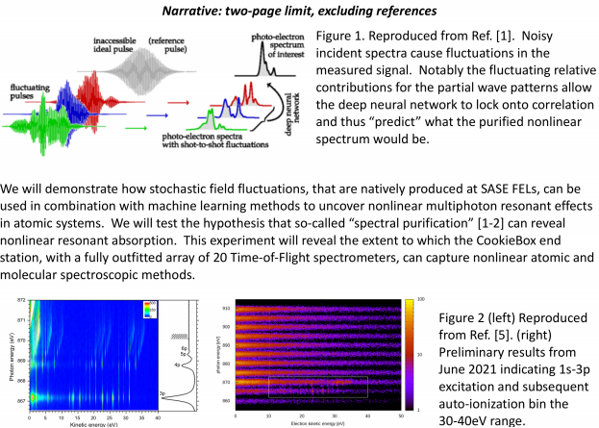
Multi-photon x-ray interference via stochastic fields
Readout
channels
Ulf Saalman and Jan Michael Rost for enhancement of non-linear signals because of SASE, Inhouse proposal submitted last Friday
“Spooktroscopy” and attoclock ptychography as super-resolution methods in the time-energy domain … Daniel Ratner engaged, Alberto Lutman mode used in beamtime
Dynamic Chirality by fs-scale time-dependent polarization shaping
<number>
Notes:
<number>

Slide 11
Enabling Accelerator R&D and nonlinear x-ray methods
Attoclocking in the FEE
Bigest question was THz in the FEE
Bam-based THz development project that could directly feed the CookieBox in the FEE with long wavelength light at rate!
LCLS-II developments CookieBox detector will support
Ago’s double XLEAP
Erik’s polarization shaping
Alberto’s Fresh Slice methods… actually how we ran June beamtime
Claudio’s Double Bunch and Harmonic Lasing
… anything FEL shaping related, multi-bunch, multi-color, multi-polarization
Scientific methods it will enable
X-ray multi-photon signals enhanced by SASE, In-house proposal
“Spooktroscopy” and attoclock ptychography as super-resolution methods in the time-energy domain … Daniel Ratner, Alberto Lutman mode used in beamtime
Dynamic Chirality by fs-scale time-dependent polarization shaping, needs DELTA undulator
<number>
Notes:
<number>

Slide 12
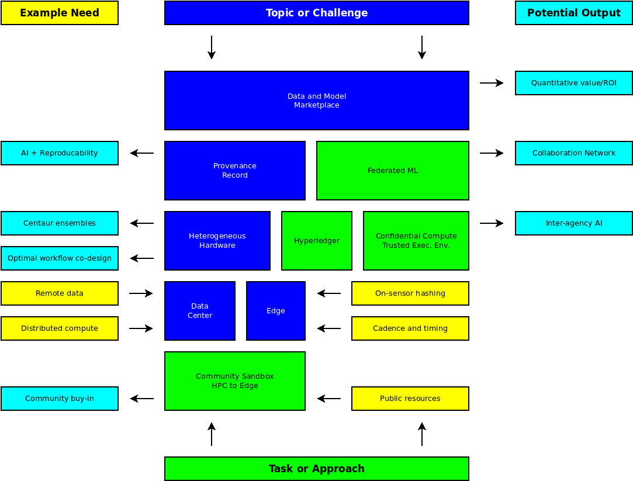
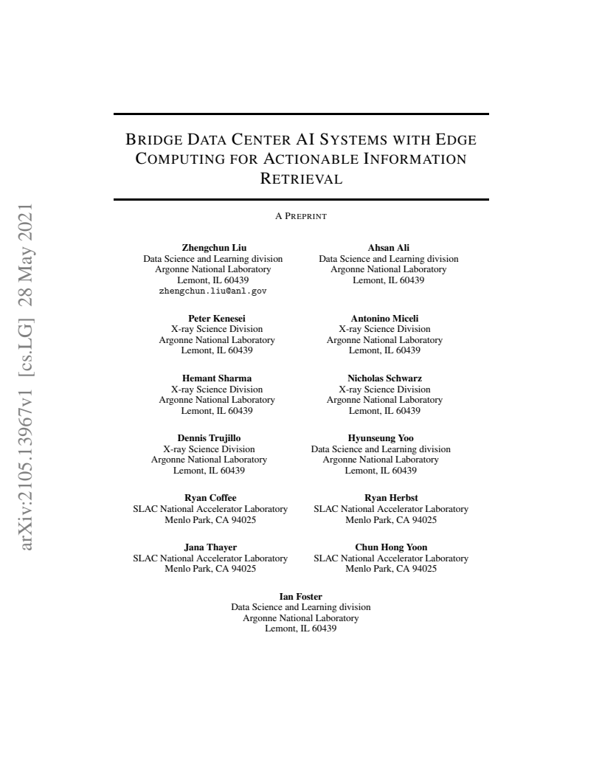
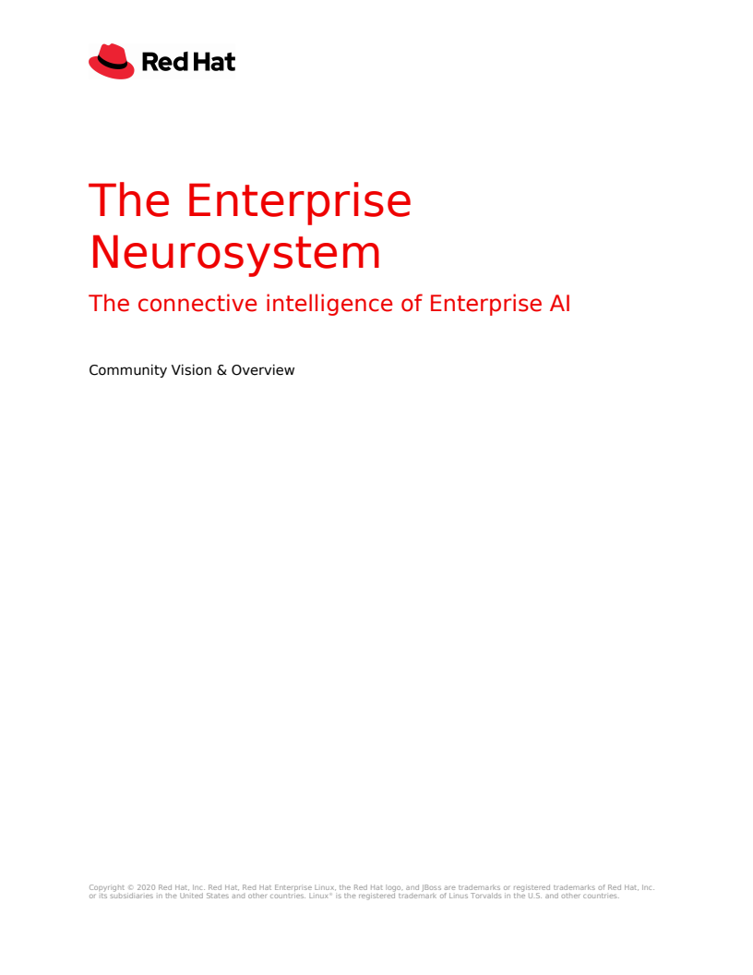
High Density Data
Developing a whitepaper for ~100M hits / s / ToF … MCP+RF+ML design (Jack, Razib, B. Adams)
Could EdgeAI board plug in as a socket to the vacuum barrier?
12
Notes:
<number>

Slide 13
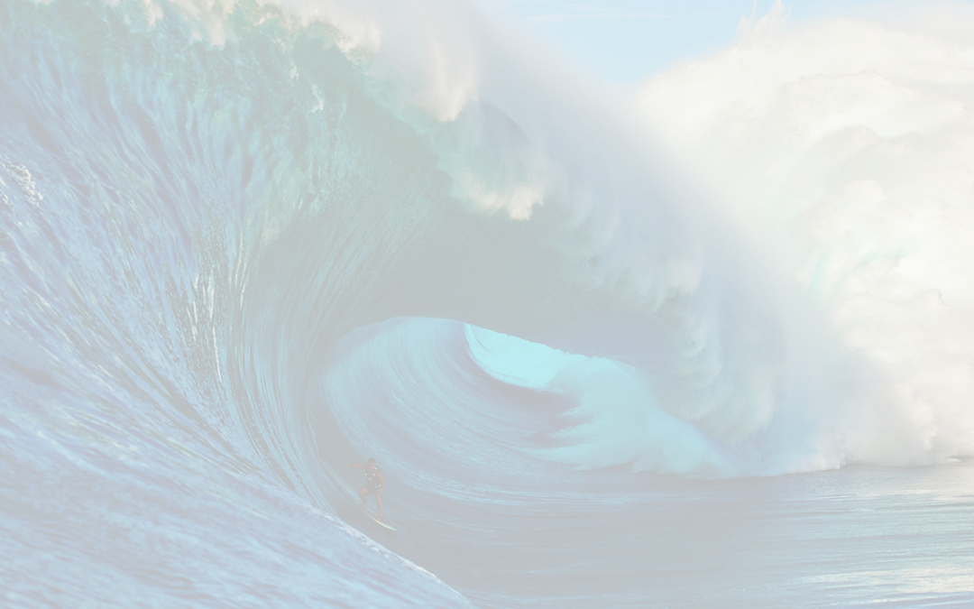
The CookieBox Team
The long team
Matt Feldman (EE/CS PhD Student / SambaNova), Audrey Corbeil-Therrein (Banting Post-Doc Fellow / Faculty @ U. Sherbrooke)
Andrei Kamalov, Razib Obaid, Averell Gatton (Clostra, Inc.)
Debadri Das, Jack Hirschman, Naoufal Layad
Jean-Charles Castagna, Hongliang Shi, Xianchao (Tony) Cheng
Peter (TMO/MRCO lead), Omar (Computing), Angelo (ASICs/Detectors), Ryan Herbst (FPGAs)
Beamtime team:
Xinxin, Xiang, Ming-Fu, Thomas, James
Jeff, Aalayah, Nolan, Sameen
Tong, Silke, Matt Weaver, Chris O’Grady
Larger Collaboration
Wolfram Helml (TU Dortmund), students: Lars Funke, Arne Held, Sara Savio
Markus Ilchen (DESY), Jens Viefhaus (HZB)
… and many others over the years
<number>
Notes:
<number>

